Slide 1


Everywhere
Flutter
@immadisairaj

Slide 2

$Who is immadisairaj
https://immadisairaj.dev
Software Developer @IBM
Flutter Developer
Open-Source Contributor
Packages in pub.dev
Musician
@immadisairaj

Slide 3
Flutter is Everywhere
Many applications built with Flutter

Slide 4
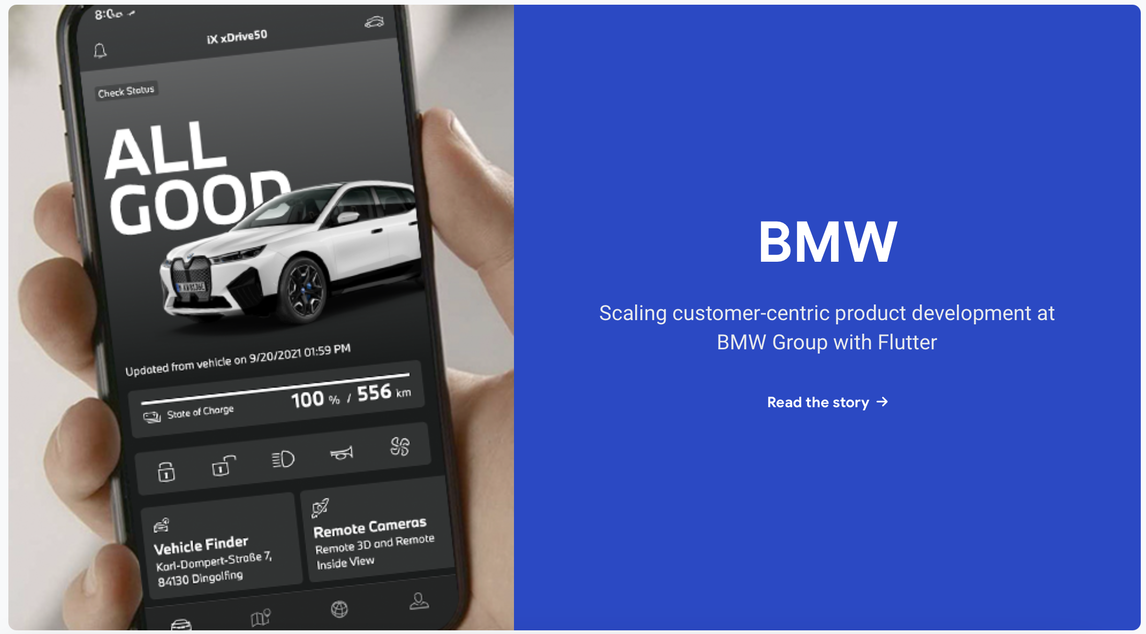


And many more..
Source: https://flutter.dev/showcase

Slide 5
Why?
One Code - All Platforms
Fast Development
Hot - Reload
Native App Similarities
Low Cost

Slide 6
Why?
One Code - All Platforms
Fast Development
HOT - RELOAD
Native App Similarities
Low Cost

Slide 7
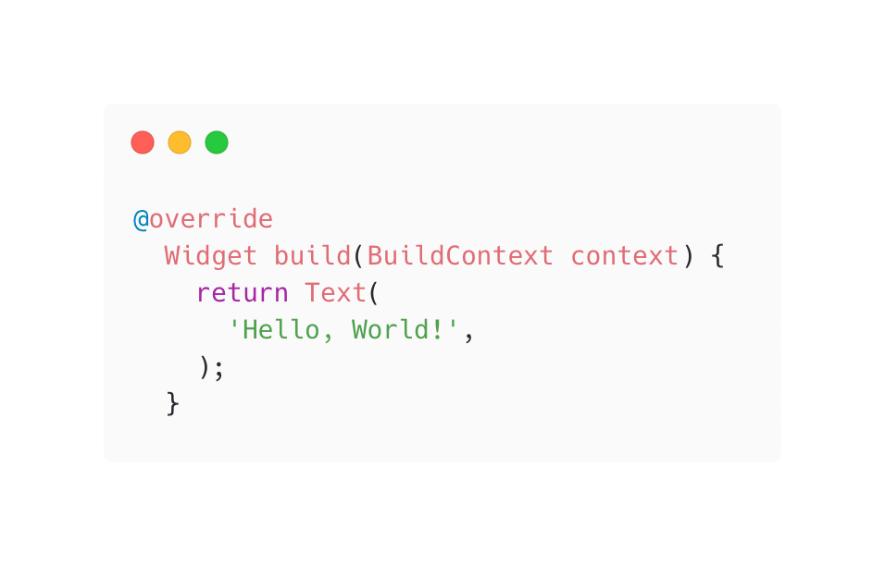
Hot - Reload

Slide 8


Hot - Reload
Dart VM

Slide 9
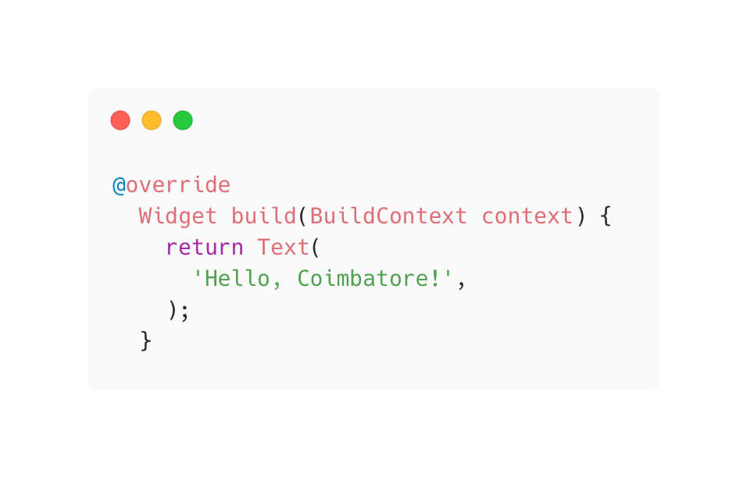
Hot - Reload
Dart VM

Slide 10
Hot - Reload
Dart VM
Framework

Slide 11
Hot - Reload
Dart VM
Update Widget Tree
Framework

Slide 12

Hot - Reload
Dart VM
Update Widget Tree
Framework

Slide 13
Trees?
Source: Kodeco.com

Slide 14

Youtube Video

Slide 15
Flutter is Everywhere
Many Platforms

Slide 16
Multi-Platform
Mobile - iOS, Android
Web
Desktop - macOS, Windows, Linux
Embedded

Slide 17
How it renders in all platforms?

Slide 18
Architecture
Source: Flutter Docs

Slide 19
Lets look at how Native works
Ex. Android
Java/Kotlin Code
Call
Canvas
Object
Android
Renders
Device
Library
Using Skia
Components
Notes:
first call the Java code of the Android framework.
The Android system libraries provide the components responsible for drawing themselves to a Canvas object,
which Android can then render with Skia

Slide 20

Usual Cross-Platform
JS or some code
Canvas
Object
Android
Renders
Device
Library
Using Skia
Abstract Layer
UI Libraries
Components
Notes:
creating an abstraction layer over the underlying native Android and iOS UI libraries, attempting to smooth out the inconsistencies of each platform representation

Slide 21

Flutter
Dart Code
Canvas
Object
Call
Flutter Engine
Renders
Using Skia
Or Impeller
Device
Flutter Library
Components
Notes:
Flutter minimizes those abstractions, bypassing the system UI widget libraries in favor of its own widget set. The Dart code that paints Flutter’s visuals is compiled into native code, which uses Skia (or, in future, Impeller) for rendering.

Slide 22
Flutter
Basically Paint a New

Slide 23
So, what about interacting with native Things?

Slide 24
Platform Channels
Source: Flutter Docs
Notes:
communicating between your Dart code and the platform-specific code of your host app

Slide 25
Foreign Function Interface (FFI)
Notes:
For C-based APIs, including modern languages like Rust or Go,
Dart provides a direct mechanism for binding to native code using the dart:ffi library.
can be considerably faster than platform channels, because no serialization is required to pass data
These are advanced topics, and no much time.. just intro

Slide 26
Thank you
@immadisairaj

